Slide 1

CUCUMBER
BDD TESTING FRAMEWORK

Slide 2
CUCUMBER
Cucumber is one of the most powerful tools. It offers us the real communication layer on top of a robust testing framework.
The tool can help run automation tests on a wide-ranging testing needs from the backend to the frontend.
Moreover, Cucumber creates deep connections among members of the testing team, which we hardly find in other testing framework.

Slide 3
Test Driven Development (TDD)
TDD is an iterative development process. Each iteration starts with a set of tests written for a new piece of functionality.
Benefits of TDD:
~ Unit test proves that the code actually works
~ Can drive the design of the program
~ Refactoring allows improving the design of the code
~ Low-Level regression test suite
~ Test first reduce the cost of the bugs

Slide 4
Drawbacks of TDD
Developer can consider it as a waste of time
The test can be targeted on verification of classes and methods and not on what the code really should do
Test become part of the maintenance overhead of a project
Rewrite the test when requirements change

Slide 5
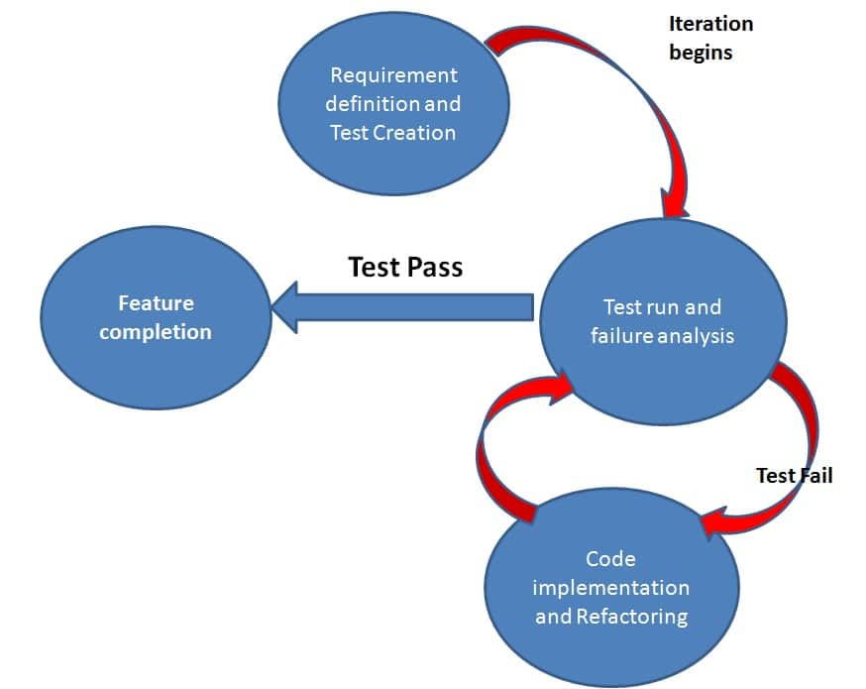
Summarizing TDD in Figure

Slide 6
Behavior-Driven Development (BDD)
Behavior Driven testing is an extension of TDD. The major difference that we get to see here are
Tests are written in plain descriptive English type grammar
Tests are explained as behavior of application and are more user-focused
Using examples to clarify requirements
This difference brings in the need to have a language that can define, in an understandable format.

Slide 7
Behavior-Driven Development (BDD)
This amazing feature of Behavior-Driven Development (BDD) approach with the advantages as below:
Writing BDD tests in an omnipresent language, a language whose structure is built around the domain model and widely used by all team members comprising of developers, testers, BAs, and customers.
Connecting technical with non-technical members of a software team.
Allowing direct interaction with the developer’s code, but we write BDD tests in a language that can also be made out by business stakeholders.
Last but not least, acceptance tests can execute automatically, while business stakeholders manually perform it.

Slide 8
Features of BDD
Shifting from thinking in “tests” to thinking in “behavior”
Collaboration between Business stakeholders, Business Analysts, QA Team and developers
Ubiquitous language, it is easy to describe
Driven by Business Value
Extends Test-Driven Development (TDD) by utilizing natural language that non-technical stakeholders can understand
Connecting technical with non-technical members of a software team.

Slide 9
Features of BDD
BDD frameworks such as Cucumber or JBehave are an enabler, acting a “bridge” between Business & Technical Language.
Allowing direct interaction with the developer’s code, but we write BDD tests in a language that can also be made out by business stakeholders.
Last but not least, acceptance tests can execute automatically, while business stakeholders manually perform it.
CONTINUE…..

Slide 10
Set Up Cucumber with Eclipse
Pre-Requisites
Set Up Java on System
Set Up Eclipse IDE or any other IDE
Set Up Maven
Create a new Maven Project
Create a ‘resources’ folder for Cucumber Tests
Add Selenium to Project
Add Maven Compiler Plugin

Slide 11
Install Cucumber Eclipse Plugin
It is easy to install Cucumber Eclipse Plugin, as it comes as a plugin for Eclipse IDE.
Prerequisite for installing this plugin is your Internet connection should be up & running during installation of this plugin and Eclipse IDE should be installed in your computer.
Please see Download and Install Eclipse to setup Eclipse to your system.

Slide 12
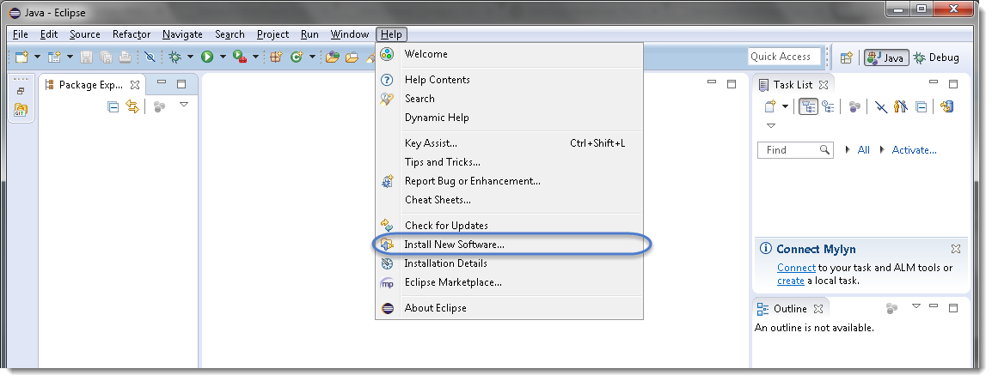
STEPS TO FOLLOW:
1) Launch the Eclipse IDE and from Help menu, click “Install New Software”.

Slide 13
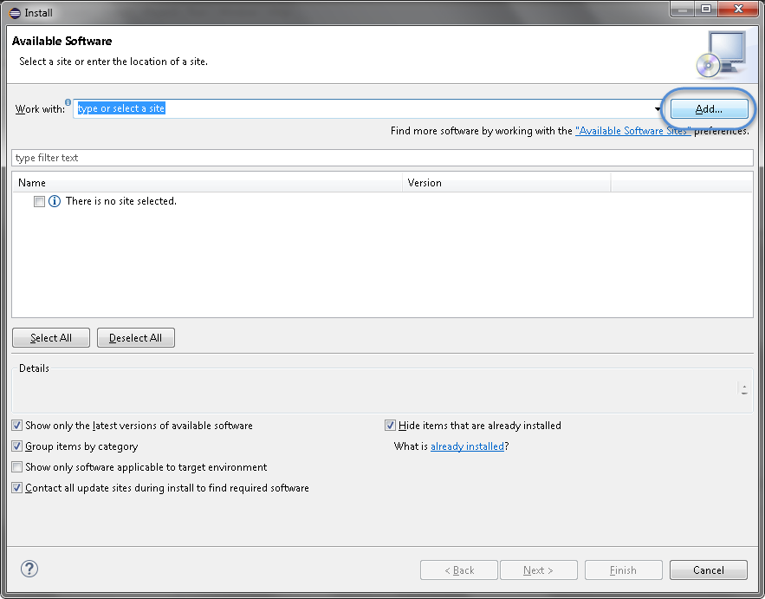
2) You will see a dialog window, click “Add” button.

Slide 14
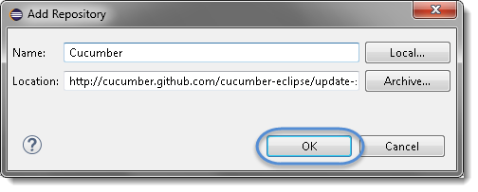
3) Type name as you wish, let’s take “Cucumber” and type “http://cucumber.github.com/cucumber-eclipse/update-site” as location. Click OK.

Slide 15
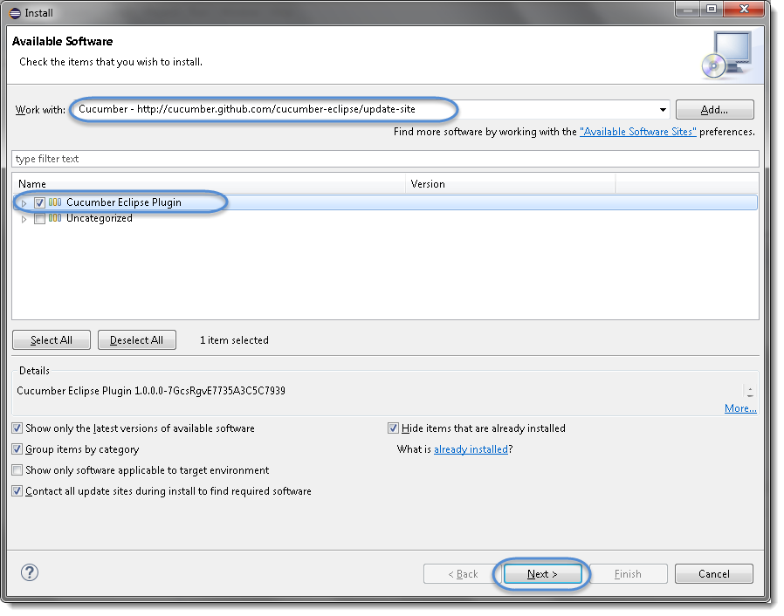
4) You come back to the previous window but this time you must see Cucumber Eclipse Plugin option in the available software list. Just Check the box and press “Next” button.
Note: If running behind a proxy server and you get a ‘HTTP Proxy Authentication Required’ error you may need to contact a system administrator to set up your proxy server settings.

Slide 16
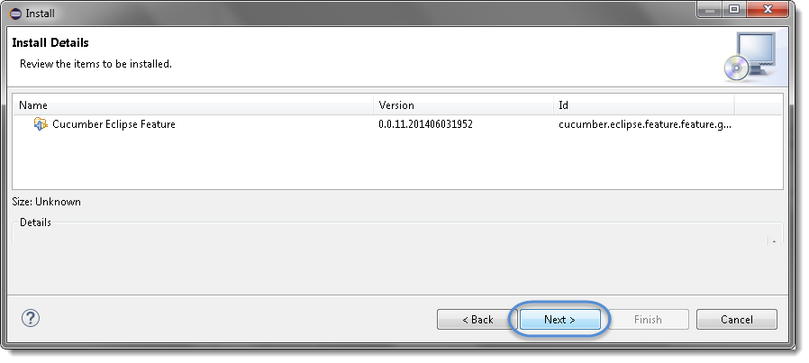
5) Click on Next.

Slide 17
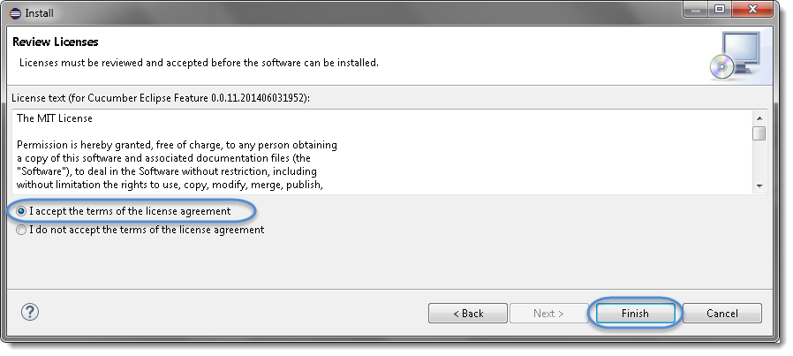
6) Click “I accept the terms of the license agreement” then click Finish.

Slide 18
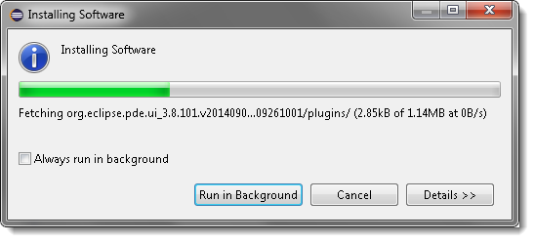
7) Let it install, it will take few seconds to complete.

Slide 19
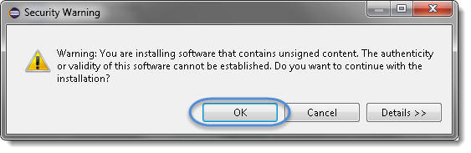
8) You may or may not encounter a Security warning, if in case you do just click OK.

Slide 20
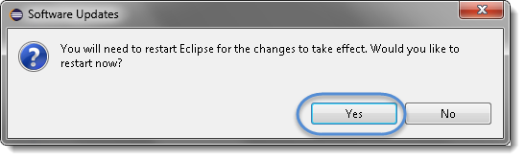
9) You are all done now, just click Yes.

Slide 21
Basic Things Of Cucumber
We must know three basic things before we write our first cucumber code.
FEATURE FILE - Feature file is the place where we will write our plain English descriptions.
RUNNER CLASS - Runner class solves this problem, @CucumberOptions provide a way to link the feature file with the step definitions. This is called "Glue".
STEP DEFINITION FILE - The Step definition file is the one, which is an actual code implementation of the steps that we have written in the feature.

Slide 22
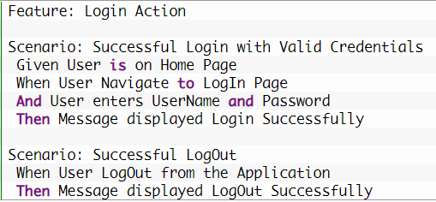
Cucumber Feature File
Cucumber proposes to write scenario in the Given/When/Then format.
A Feature File is an entry point to the Cucumber tests.
This is a file where you will describe your tests in Descriptive language (Like English) called Gherkin. It is an essential part of Cucumber, as it serves as an automation test script as well as live documents.
A feature file can contain a scenario or can contain many scenarios in a single feature file, but it usually contains a list of scenarios.

Slide 23
Cucumber Feature File – Gherkin Keyword
You will quickly notice that there are some colored words. These words are Gherkin keywords, and each keyword holds a meaning.
Here is the list of keywords that Gherkin supports:
Feature
Background
Scenario
Given
When
Then
And
But
*

Slide 24
Gherkin Keywords
Feature Keyword
Each Gherkin file begins with a Feature keyword. Feature defines the logical test functionality you will test in this feature file.
Background Keyword
Background keyword is used to define steps that are common to all the tests in the feature file.
Scenario Keyword
Each Feature will contain a number of tests to test the feature. Each test is called a Scenario and is described using the Scenario: keyword.

Slide 25
Gherkin Keywords
Given Keyword
Given defines a precondition to the test.
When Keyword
When keyword defines the test action that will be executed.
Then Keyword
Then keyword defines the Outcome of previous steps.
And Keyword
And keyword is used to add conditions to your steps.
But Keyword
But keyword is used to add negative type comments. It is not a hard & fast rule to use but only for negative conditions.
It makes sense to use But when you will try to add a condition which is opposite to the premise your test is trying to set.

Slide 26
Gherkin Keywords
* Keyword
This keyword is very special. This keyword defies the whole purpose of having Given, When, Then and all the other keywords. Basically, Cucumber doesn’t care about what Keyword you use to define test steps, all it cares about what code it needs to execute for each step. That code is called a step definition . All the keywords can be replaced by the * keyword and your test will just work fine.
Let’s see with example:
Feature: LogIn Action Test Description: This feature will test a LogIn and LogOut functionality
Scenario: Successful Login with Valid Credentials Given User is on Home Page When User Navigate to LogIn Page And User enters UserName and Password Then Message displayed Login Successfully
Using * Keyword
Feature: LogIn Action Test Description: This feature will test a LogIn and LogOut functionality
Scenario: Successful Login with Valid Credentials * User is on Home Page * User Navigate to LogIn Page * User enters UserName and Password * Message displayed Login Successfully

Slide 27
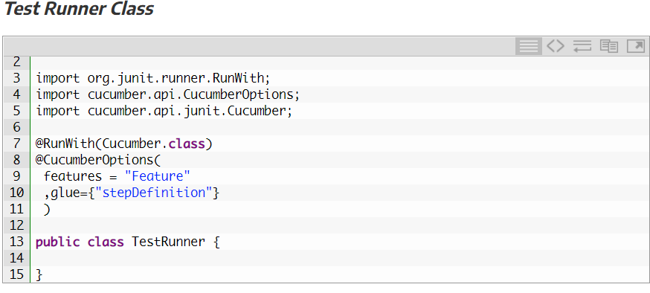
JUnit Test Runner Class
As Cucumber uses Junit we need to have a Test Runner class.
It more like a starting point for Junit to start executing your tests.
@RunWith annotation tells JUnit that tests should run using Cucumber class present in ‘Cucumber.api.junit‘ package.
The @CucumberOptions present in ‘cucumber.api.CucumberOptions‘ package tells Cucumber a lot of things like where to look for feature files, what reporting system to use and some other things also.

Slide 28
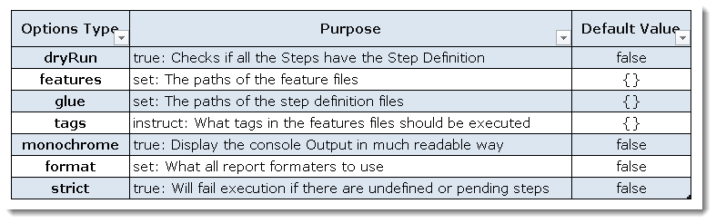
JUnit Test Runner Class - @CucumberOptions
In layman language, @CucumberOptions are like property files or settings for your test.
Basically @CucumberOptions enables us to do all the things that we could have done if we have used cucumber command line.
This is very helpful and of utmost importance, if we are using IDE such eclipse only to execute our project.
we can say that @CucumberOptions are used to set some specific properties for the Cucumber test.
Following Main Options are available in Cucumber:

Slide 29
THE FIRST CUCUMBER TEST CASE!
Task: Open Google.com using Selenium-Cucumber and perform a search operation

Slide 30
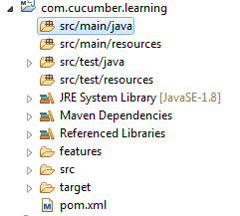
Steps for writing the first test case for our task using Cucumber:
It will take some time and once the project is created you can see the project structure like this.
STEP 1:
Create a new Maven project in Eclipse and give a suitable name.
(com.cucumber.learning) is my project name. You can even create a normal Java project but adding and removing the referenced libraries will be some difficult task.
If we use Maven, managing dependencies will be very easier with pom.xml.

Slide 31
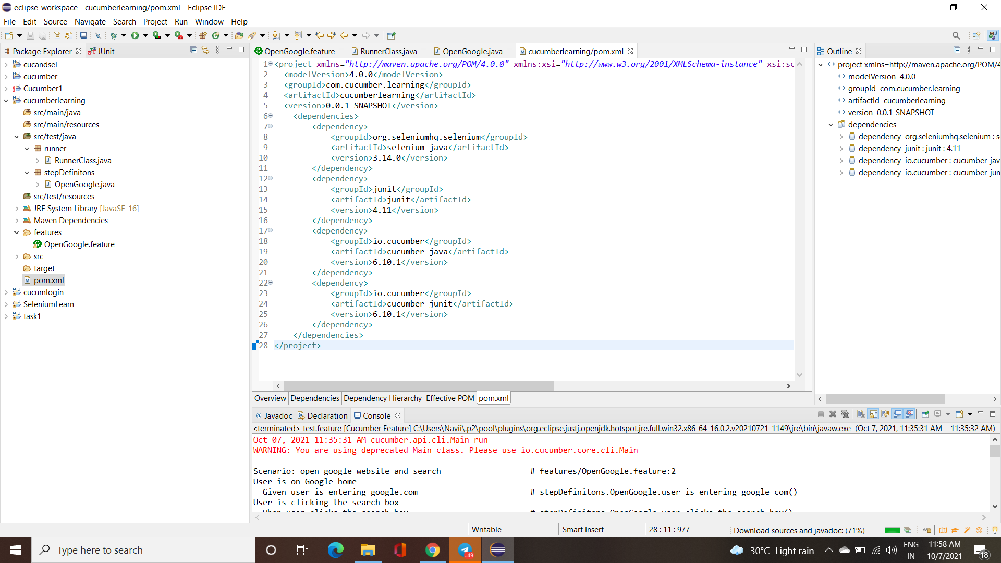
STEP 2:
We have not added the necessary jars to the project. So, to add those jars, all we have to do is include the maven dependencies in the pom.xml file from mvn repository and you can see the jars are getting downloaded and once it is finished you can see the maven dependencies.

Slide 32
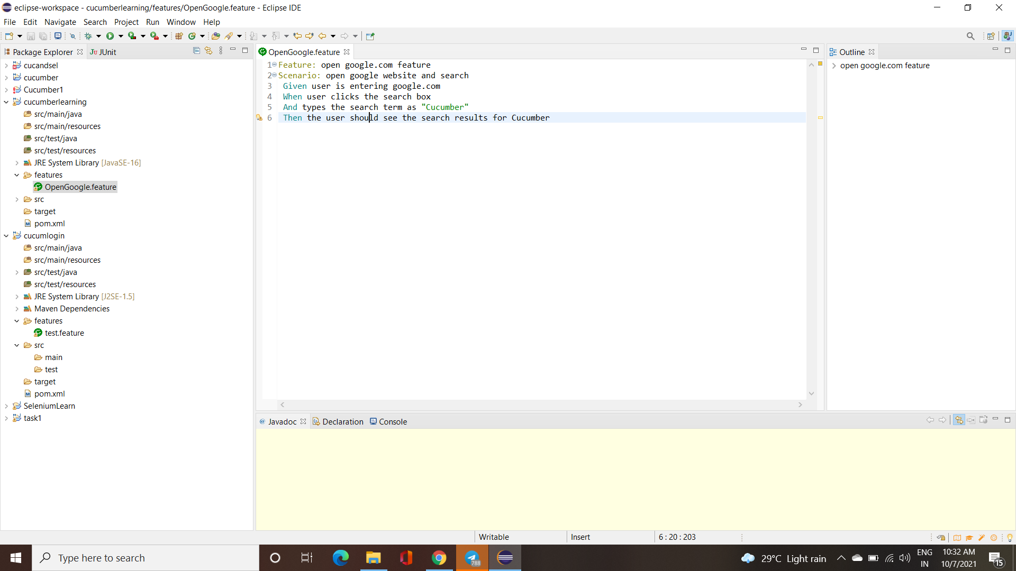
STEP 3:
Under the project create a folder named "features" this is where we are going to create our feature files.
Inside the features folder, let us create our first feature file called "OpenGoogle.feature".
In the newly created feature file, we are going to write the steps (behaviours) for our test scenario.

Slide 33
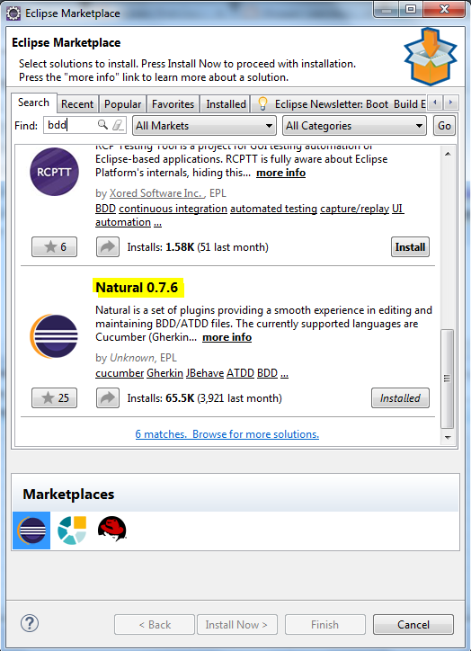
STEP 4:
If you are getting only black text and no other color differentiation in feature file , then that is not a big issue.
I Go to your Eclipse marketplace and search for BDD, you will get some results and install a plugin called Natural.

Slide 34
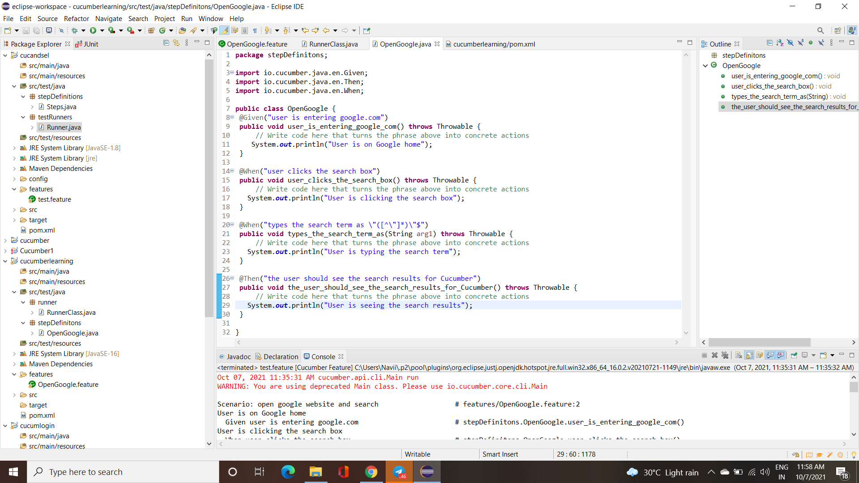
STEP 5:
After writing the feature file, we have to write the step definitions for the feature file. Step definition class is nothing but the actual code implementation of plain English that we have given in the feature file.
Under src/test/java create a package named "stepDefinitons" and inside that create a class called "OpenGoogle".

Slide 35
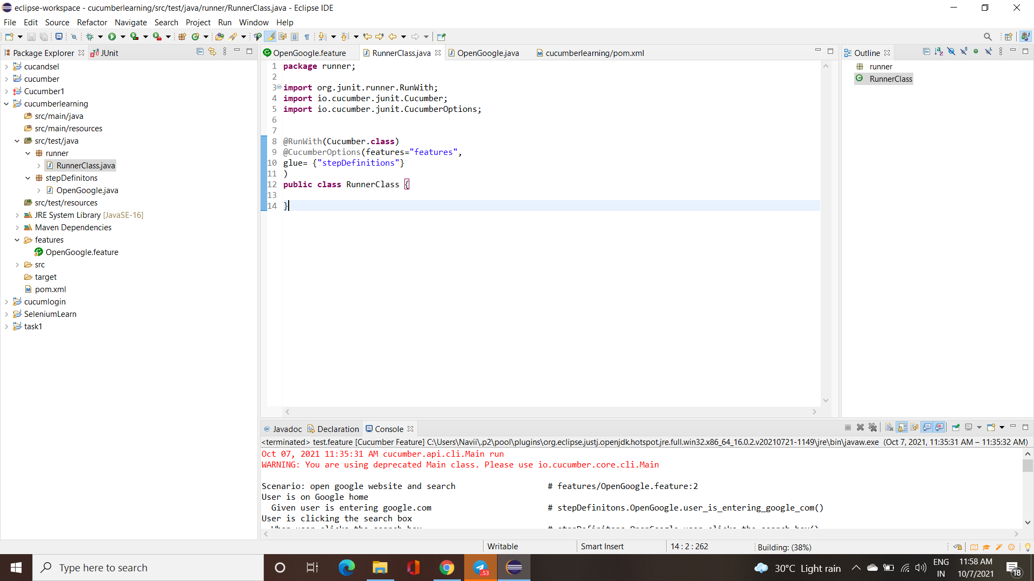
STEP 6:
Now under, src/test/java create another package called "runner" and inside that create a class named "RunnerClass".
This is where we run all our tests. This will be the entry point of our program.
Run the RunnerClass as JUnit Test. You can see the steps that we have written in our feature file are automatically getting mapped to a java method with the Given, When, And, Then annotations

Slide 36
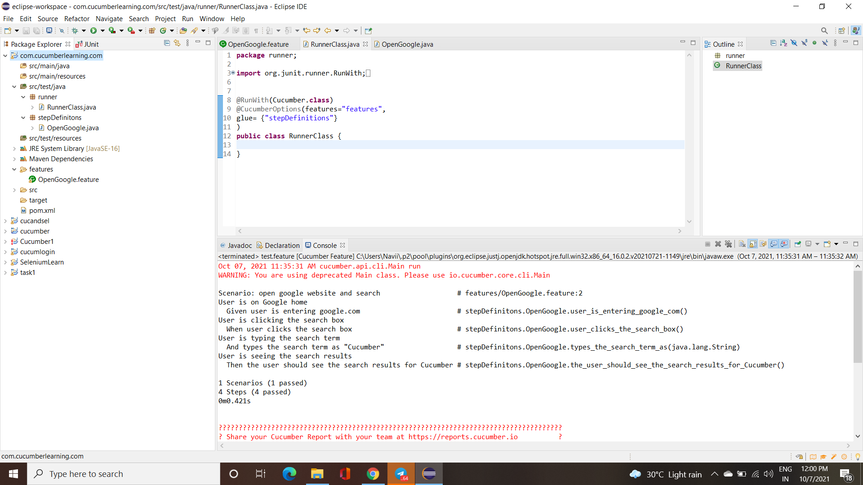
STEP 7:
Run the Cucumber Test
Even from the IDE, there are a couple of ways to run these feature files.
Click on the Run button on eclipse and you have your test run
Right Click on Runner class and Click Run As > JUnit Test Application
CONSOLE OUTPUT:

Slide 37
CUCUMBER
STRUCTURE

Slide 38
Data Driven Testing in Cucumber
Cucumber inherently supports Data Driven Testing using Scenario Outline.
There are different ways to use the data insertion within the Cucumber and outside the Cucumber with external files.
Data-Driven Testing in Cucumber
Parameterization without Example Keyword
Data-Driven Testing in Cucumber using Scenario Outline
Parameterization with Example Keyword
Parameterization using Tables
Data-Driven Testing in Cucumber using External Files
Parameterization using Excel Files
Parameterization using Json
Parameterization using XML

Slide 39
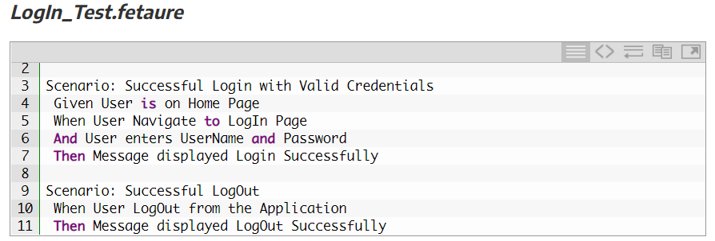
Scenario Outline – This is used to run the same scenario for 2 or more different sets of test data. E.g. In our scenario, if you want to register another user you can data drive the same scenario twice.
DATA-DRIVEN TESTING - Example

Slide 40
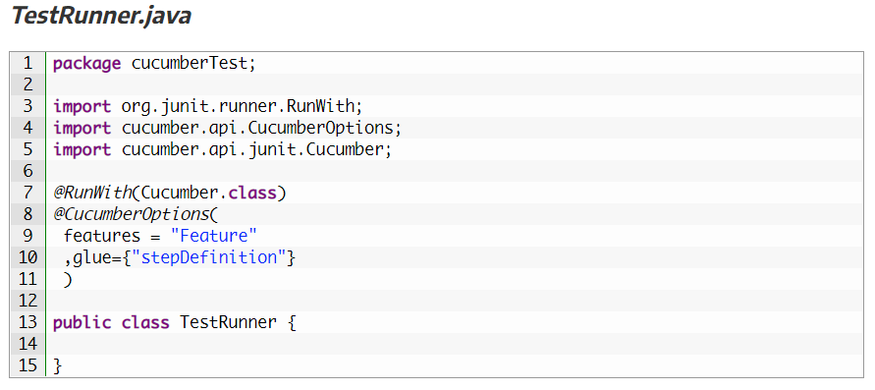
DATA-DRIVEN TESTING - Example

Slide 41
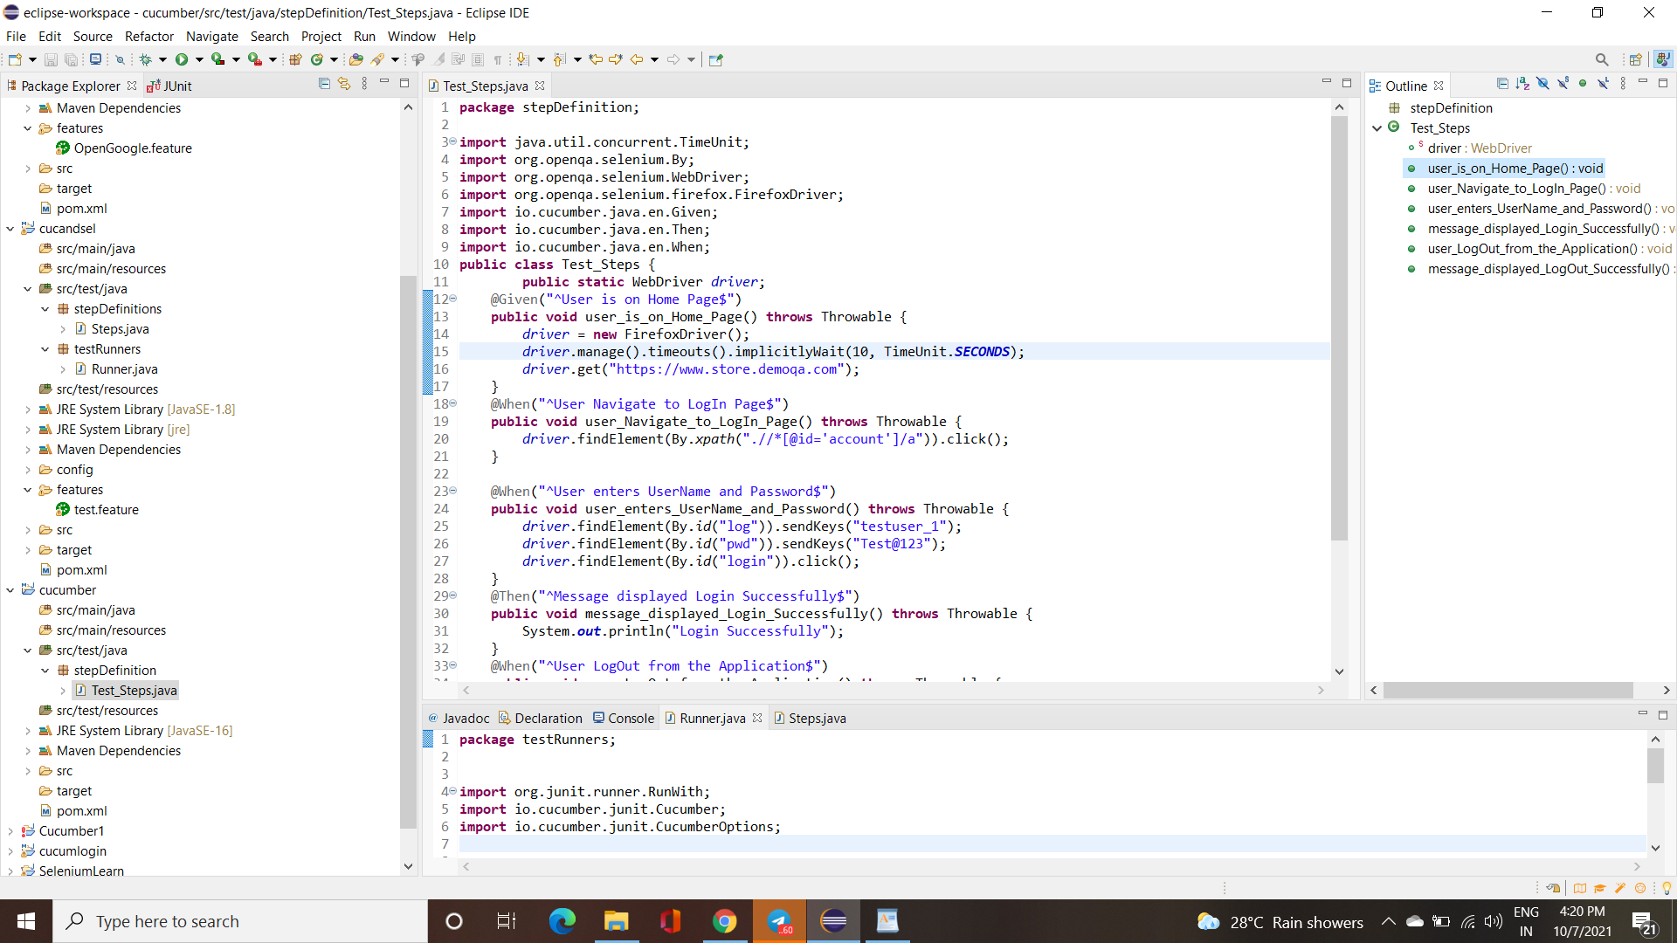
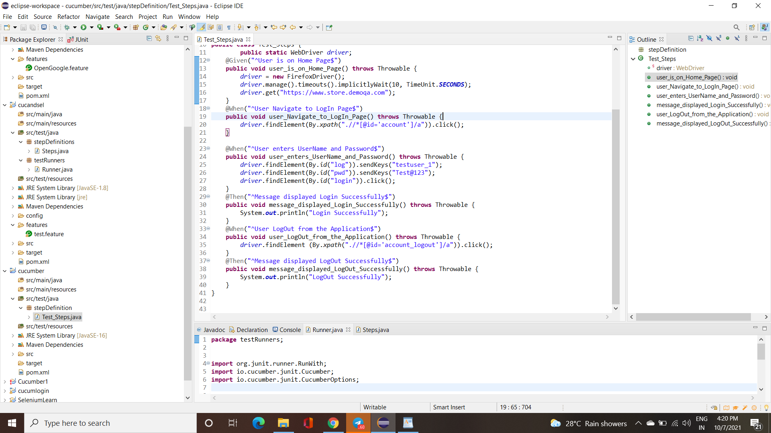
DATA-DRIVEN TESTING - Example

Slide 42
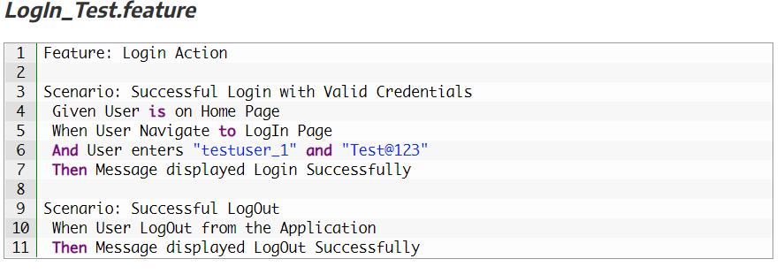
Parameterizing without Example Keyword
1) Go to the Feature File and change the statement where passing Username & Password as per below:
And User enters “testuser_1” and “Test@123“
In the above statement, we have passed Username & Password from the Feature File which will feed in to Step Definition of the above statement automatically.

Slide 43
Parameterizing without Example Keyword
2) Changes in the Step Definition file is also required to make it understand the Parameterization of the feature file. So, it is required to update the Test Step in the Step Definition file which is linked with the above-changed Feature file statement. Use the below code:
@When(“^User enters \”(.*)\” and \”(.*)\”$”)
The same can be achieved by using the below code as well:
@When(“^User enters \”([^\”]*)\” and \”([^\”]*)\”$”)

Slide 44
Parameterizing without Example Keyword
3) Same parameters should also go into the associated Test_Step.
As the Test step is nothing but a simple Java method, syntax to accept the parameter
in the Java method is like this:
public void user_enters_UserName_and_Password(String username, String password) throws Throwable {
}

Slide 45
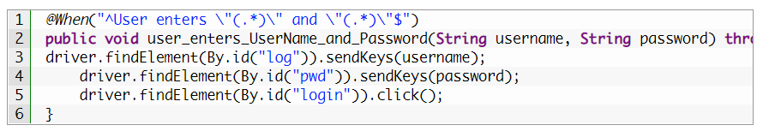
Parameterizing without Example Keyword
4) Now the last step is to feed the parameters in the actual core statements of Selenium WebDriver. Use the below code:
driver.findElement(By.id(“log“)).sendKeys(username); driver.findElement(By.id(“pwd“)).sendKeys(password); driver.findElement(By.id(“login“)).click();
5) Run the test by Right Click on TestRunner class and Click Run As > JUnit Test Application.
You would notice that the Cucumber will open the Website in the browser and enter username & password
which is passed from the Feature File.

Slide 46
Data Driven Testing Using Examples Keyword
1) Enter the Example Data just below the LogIn Scenario of the Feature File.
Examples: | username | password | | testuser_1 | Test@153 | | testuser_2 | Test@153 |
Note: The table must have a header row corresponding to the variables in the Scenario Outline steps.
The Examples section is a table where each argument variable represents a column in the table, separated by “|”. Each line below the header represents an individual run of the test case with the respective data.

Slide 47
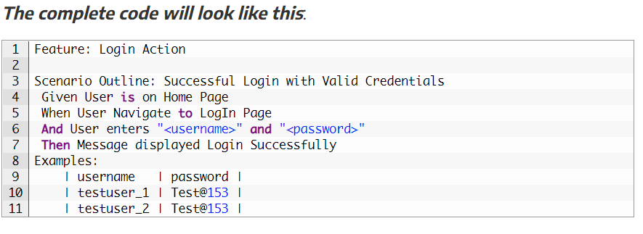
Data Driven Testing Using Examples Keyword
2) Need to update the Statement in the feature file, which tells Cucumber
to enter username & Password.
And User enters <username> and <password>

Slide 48
Data Driven Testing Using Examples Keyword
3) There are no changes in TestRunner class.
4) There are no changes in Test_Steps file.
5) Run the test by Right Click on TestRunner class and Click Run As > JUnit Test Application.
This takes the parameterization one step further: now our scenario has “variables” and they get filled in by the values in each row.

Slide 49
Data Tables in Cucumber
Scenario Outline:
This uses Example keyword to define the test data for the Scenario
This works for the whole test
Cucumber automatically run the complete test the number of times equal to the number of data in the Test Set
Test Data:
No keyword is used to define the test data
This works only for the single step, below which it is defined
A separate code needs to understand the test data and then it can be run single or multiple times but again just for the single step, not for the complete test

Slide 50
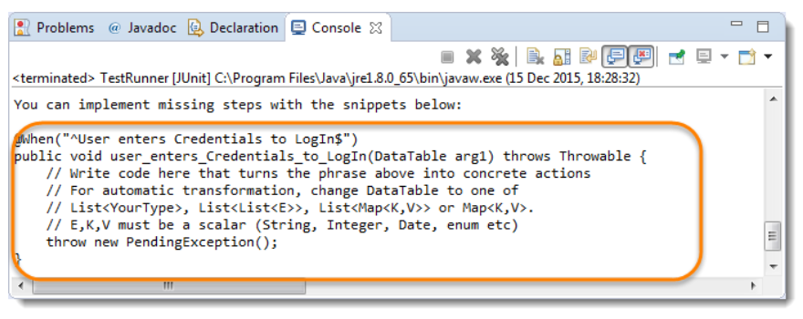
Data Tables can be used in many ways because it has provided many different methods to use.
we will pass the test data using the data table and handle it using Raw() method
The complete scenario is same as what we have done earlier. But the only difference is in this, we are not passing parameters in the step line and even we are not using Examples test data. We declared the data under the step only. So, we are using Tables as arguments to Steps.
If you run the above scenario without implementing the step, you would get the following error in the Eclipse console window.

Slide 51
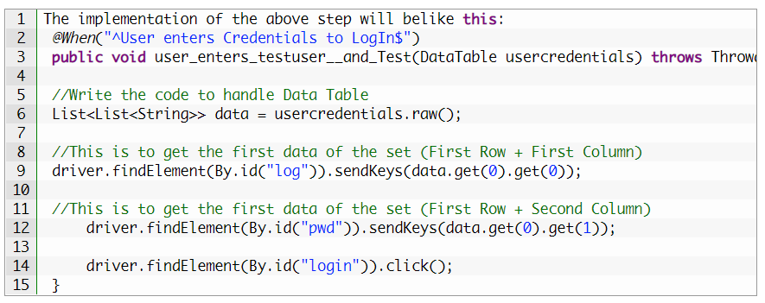
The implementation of these step
will be like this:

Slide 52
Maps in Data Tables
Maps in Data Tables
Maps in Data Tables can be used if different ways. Headers can also be defined for the data tables. A same step can be executed multiple times with different set of test data using Maps.
Maps in Data Tables with Multiple Test Data
In this test we will pass Username and Password two times to the test step. So our test should enter Username & Password once, click on LogIn button and repeat the same steps again.

Slide 53
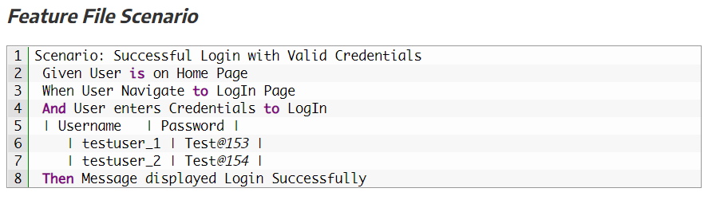
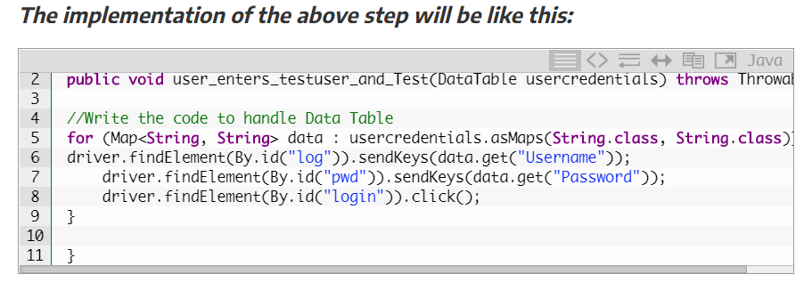
IMPLEMENTATION OF MAPS
IN
DATA TABLES

Slide 54
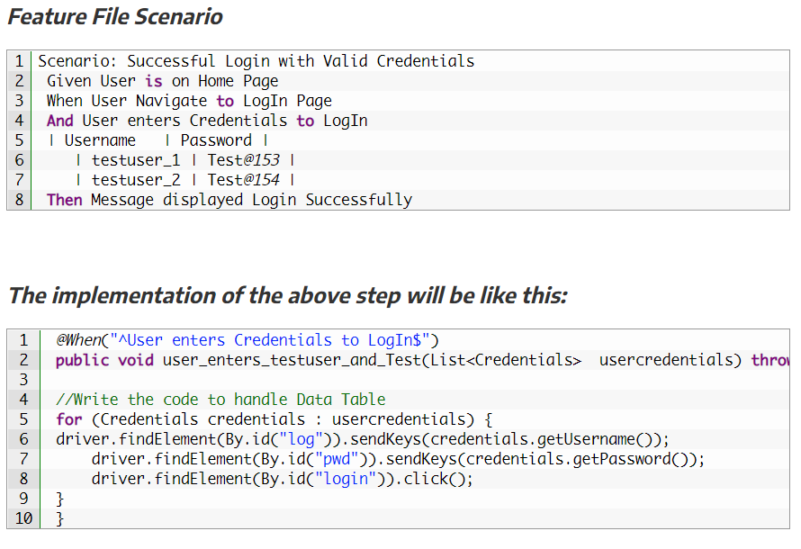
Map Data Tables to
Class Objects
Luckily there are easier ways to access your data than Data Table.
For instance, you can create a Class-Object and have Cucumber map the data in a table to a list of these.

Slide 55
What are Tags in Cucumber?
Features and Scenarios can be marked with Tags
Tags use @ symbol with some text e.g. @SmokeTest
In the test runner we can run specific tags
A feature or scenario can have multiple tags

Slide 56
Features Of Tags
Runs with single OR multiple Tags
Runs with a combination of tags or using AND, OR conditions
Can skip scenarios having specific Tag

Slide 57
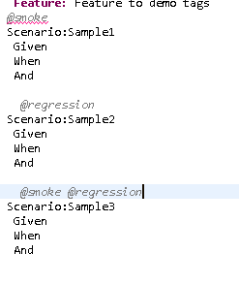
FEATURE File
~ Saved in .feature Extension

Slide 58
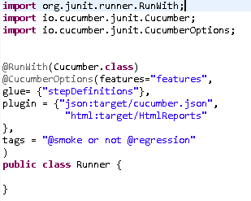
Runner File

Slide 59
Types Of Tags
Single tag
tags = {​​​​​​​"@smoke"}​​​​​​​
Multiple tags
Tags with AND OR conditions
tags = {​​​​​​​"@smoke or @regression"}​​​​​​​
tags = {​​​​​​​"@smoke and @regression"}​​​​​​​
tags = {​​​​​​​"@smoke and not @regression"}​​​​​​​
To Skip or Ignore Tags
tags = {​​​​​​​"(@smoke or @regression) and not @important"}​​​​​​​

Slide 60
Useful tips Tags
Tags can be placed below the following gherkin elements:
Feature
Scenario
Scenario Outline
Examples
It is not possible to place tags above Background or steps (Given, When, Then, And and But

Slide 61
Useful Tips Tag Inheritance
Tags are inherited by child elements.
Tags that are placed above a feature will be inherited by scenario, scenario outline, or examples.
Tags that are placed above a scenario outline will be inherited by examples

Slide 62
What are Hooks in Cucumber?
Blocks of code that runs before OR after each scenario
Hooks in cucumber are like listeners in testing
Can define hooks by using annotations @before @after

Slide 63
Types Of Hooks
Scenario Hooks
Runs before and after each scenario
Step Hooks
Runs before and after each step
Conditional Hooks
Hooks associated with tags for conditional execution

Slide 64
Why to use HOOKS?
To manage the setup and teardown
To avoid rewriting the common setup or teardown actions
Allow better management of code workflow

Slide 65
How To Use Hooks?
Step 1 - create a new or use an existing feature file
Step 2 - create the steps for the scenario in the feature file
Step 3 - create setup and teardown methods and mark with annotation
@Before
@After
@Beforesteps
@Aftersteps
Step 4 - create new or use an existing testrunner class
Step 5 - run the testrunner class and check execution

Slide 66
Conditional Hooks
Conditional Hooks
Hooks can be conditionally selected for execution based on the tags of the scenario
To run a particular hook only for certain scenarios, you can associate a Before or After hook with a tag expression
Tags can be used with
@BeforeSteps
@AfterSteps
@After(value="@smoke", order=2)
Ordering Hooks
We can use multiple Before and After hooks and also assign order of execution
@Before(order=0)
@Before(order=1)

Slide 67
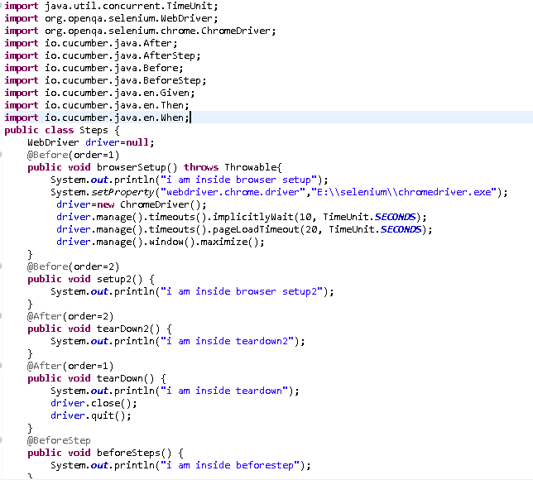
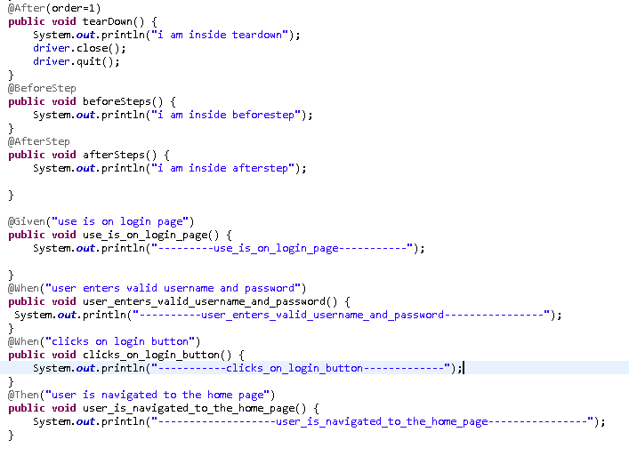
Example Program - Hooks

Slide 68
Background in Cucumber
Background in Cucumber is used to define a step or series of steps that are common to all the tests in the feature file.
It allows you to add some context to the scenarios for a feature where it is defined.
A Background is much like a scenario containing a number of steps.
But it runs before each and every scenario were for a feature in which it is defined.

Slide 69
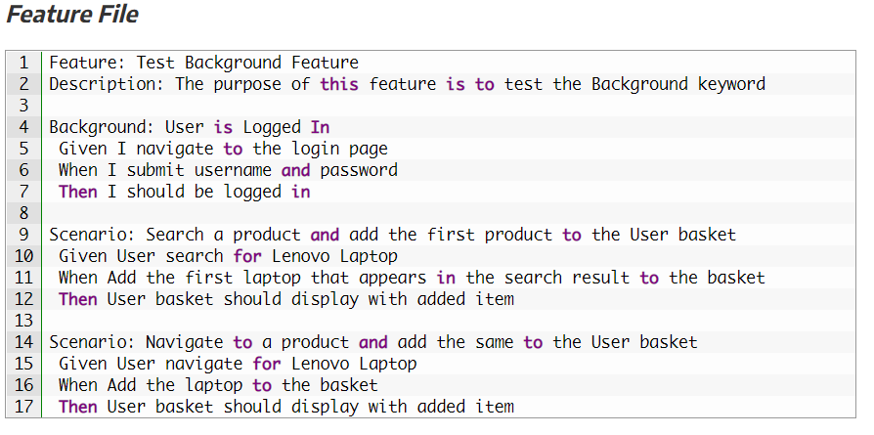
For example, To purchase a product on any E-Commerce website, you need to do the following steps: Navigate to Login Page Submit UserName and Password After these steps only you will be able to add a product to your cart/basket and able to perform the payment. Now as we are in a feature file where we will be testing only the Add to Cart or Add to Bag functionality, these tests become common for all tests. So instead of writing them again and again for all tests, we can move it under the Background keyword
Background in Cucumber – Example Scenerio

Slide 70
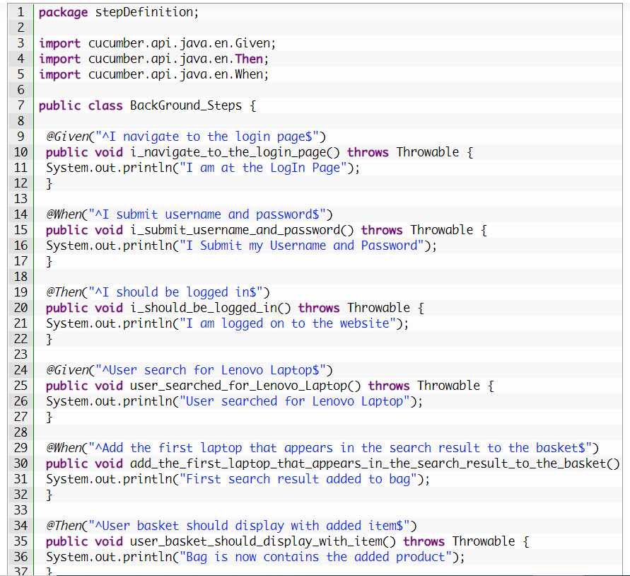
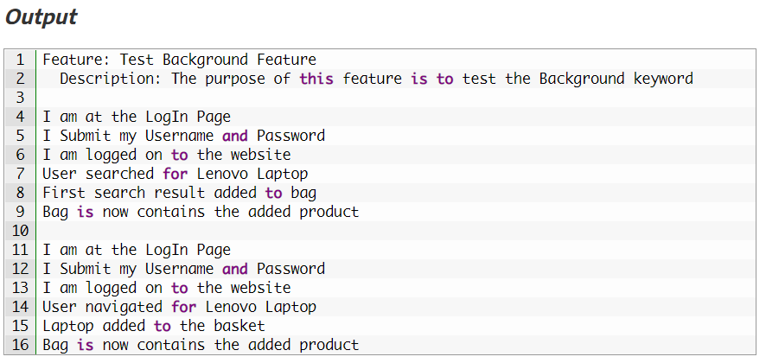
In the above example, we have two different scenarios where a user is adding a product from search and directly from the product page. But the common step is to logIn to website for both the scenario. Therefore, we create another Scenario for Login but named it as Background rather than a Scenario. So that it executes for both the Scenarios.
StepDefinition
Background in Cucumber – Example Scenerio

Slide 71
Cucumber Reports
When ever we do test execution, it is also required to understand the output of the execution. Whether it is Manual execution or an Automated, the output of the same must be in format, which immediately depicts the overall results of the execution.
Hence, our framework also should have the same capability to create output or generate test execution reports.
It is essential to know, how better we can generate our Cucumber test reports.
As we know that Cucumber is a BDD framework, it does not have a fancy reporting mechanism. In order to achieve this, Cucumber itself has provided a nice feature to generate reports.

Slide 72
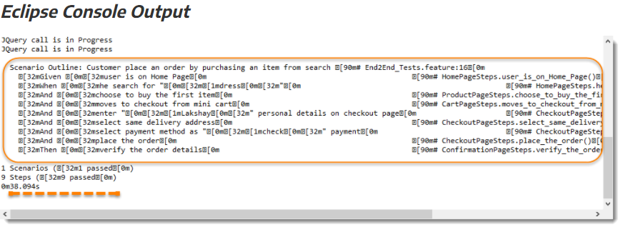
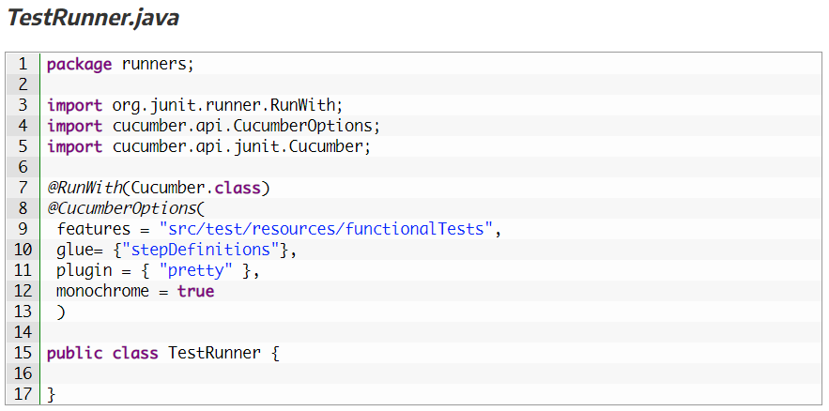
Complete TestRunner would look like this:
Pretty Report
The first plugin, we will talk about is Pretty. This provides more verbose output. To implement this, just specify plugin = “pretty” in CucumberOptions. This is what the code looks like:
@CucumberOptions( plugin = { “pretty” } )

Slide 73
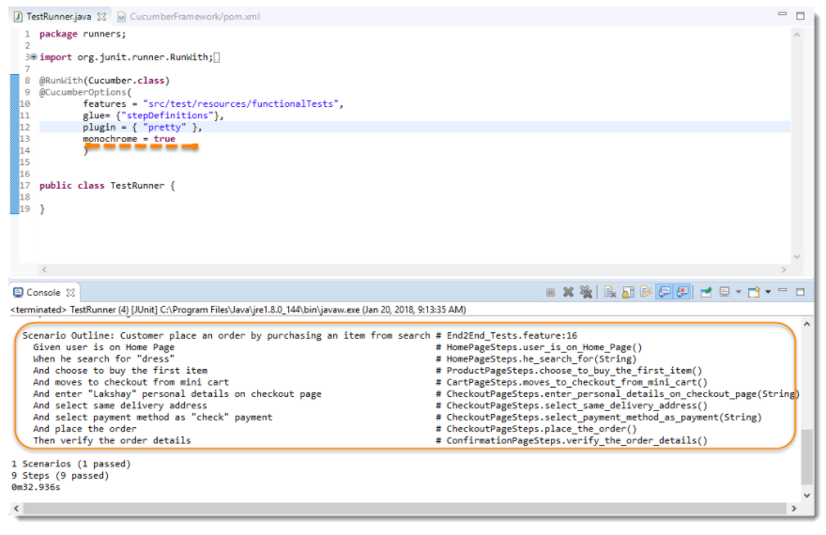
Full CucumberOption code will be like this:
Monochrome Mode Reporting
If the monochrome option is set to false, then the console output is not as readable as it should be. The output when the monochrome option is set to false is shown in the above example. It is just because, if the monochrome is not defined in Cucumber Options, it takes it as false by default. How to specify it:
@CucumberOptions( monochrome = true );

Slide 74
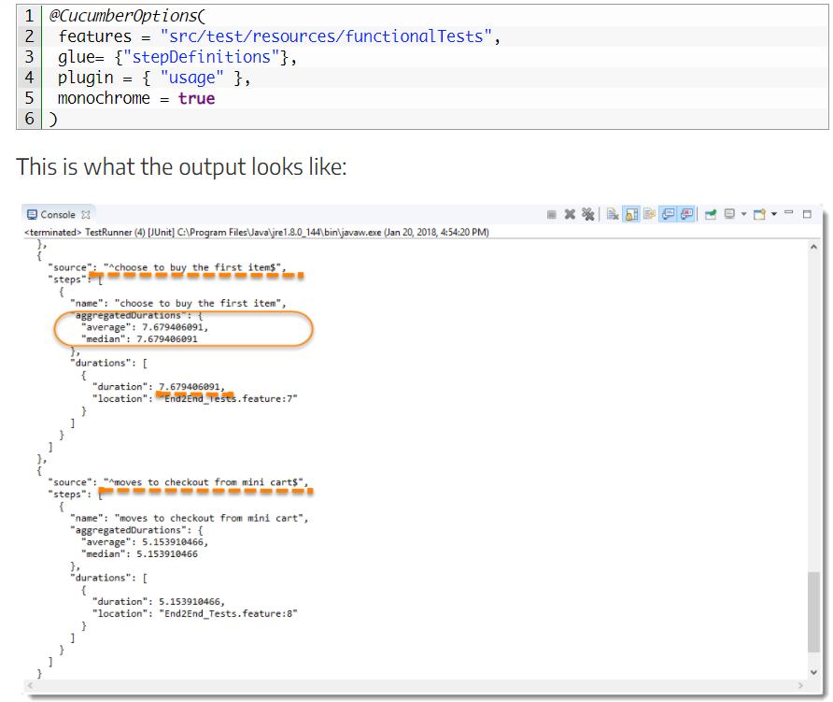
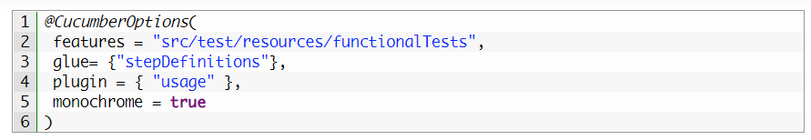
Full CucumberOption code will be like this:
Usage Report
If we are more concerned about the time taken by each Step Definition, then we should use the usage plugin. This is how we specify the same in @CucumberOptions:
@CucumberOptions( plugin = { “usage” })

Slide 75
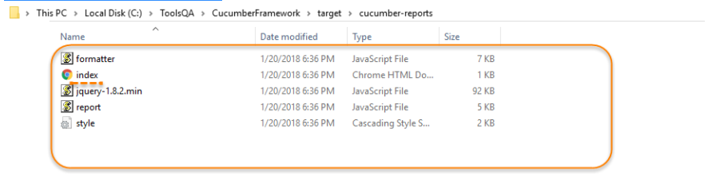
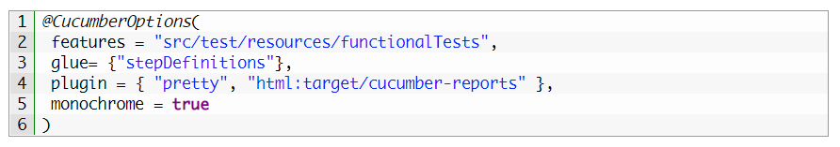
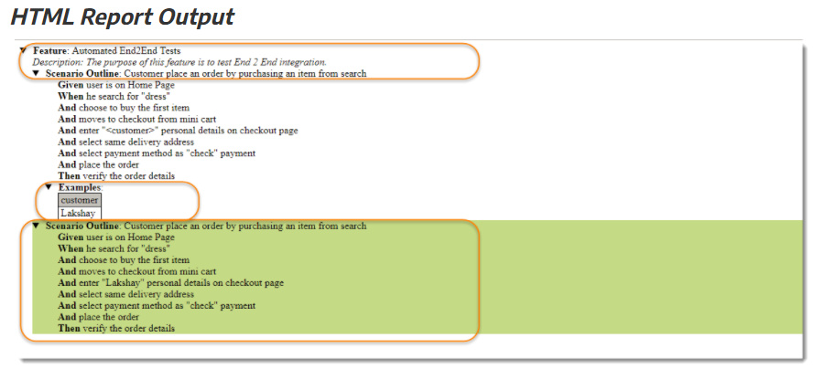
Full CucumberOption code will be like this:
Report Output Location
Cucumber HTML Reports
For HTML reports, add html:target/cucumber-reports to the @CucumberOptions plugin option
Note: We have specified the path of the Cucumber report, which we want it to generate it under the target folder.
This will generate an HTML report at the location mentioned in the formatter itself.

Slide 76
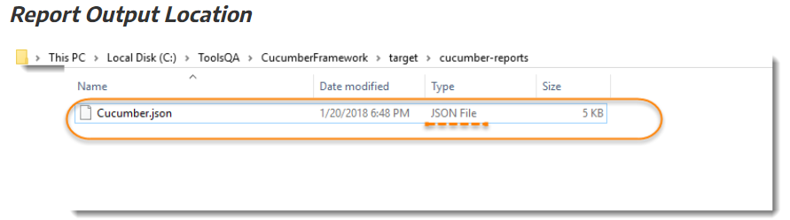
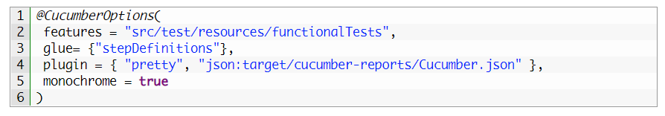
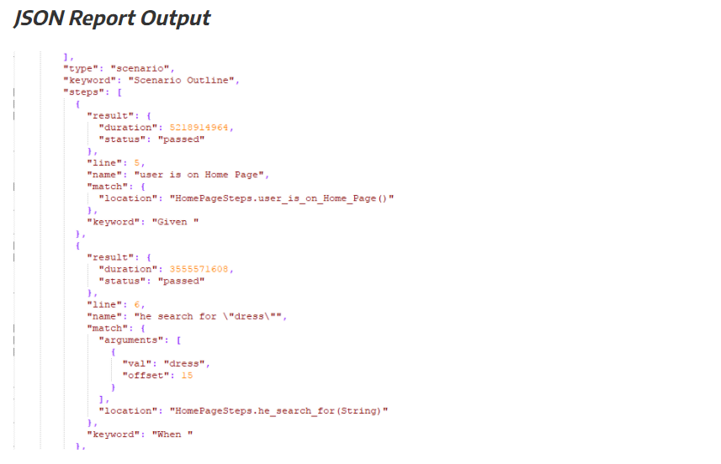
Full CucumberOption code will be like this:
Cucumber JSON Report
For JSON reports,
add json:target/cucumber-reports/Cucumber.json to the @CucumberOptions plugin option.

Slide 77


Full CucumberOption code will be like this:
Cucumber JUNIT XML Report
For JUNIT reports,
add junit:targe/cucumber-reports/Cucumber.xml to the @CucumberOptions plugin option.

Slide 78

Full CucumberOption code will be like this:
All Reports Together
We can even generate all reports together as well.

Slide 79
Cucumber Extent Report
This is again an awesome plugin that is built on Extent Report specially for Cucumber by Vimal Selvam.
This is why it is named as Cucumber Extent Reporter.
This one is made to ease the implementation of Extent Report in Cucumber Framework.

Slide 80


Let’s start by implementing the same in our Selenium Cucumber Framework.
Add Extent Report library
Dependencies information can be taken from Maven Repository – Extent Report.
Step 1: Add Cucumber Extent Reporter library to Maven Project
This is really simple, as we have been using Maven Project, all we need to do is to add the dependencies in to the project POM file. Dependencies information can be taken from Maven Repository – Cucumber Extent Reporter.

Slide 81
1. Create a New File and name it as extent-config.xml by right click on the configs folder in the project. In this config file you can set many elements like :
Report Theme : <theme> : standard or dark
Document Encoding : <encoding> : UFT-8
Title of the Report : <documentTitle> : This will display on the Browser Tab
Name of the Report: <reportName>: This will display at the top of the Report
Global Date Format : <dateFormat> : Like this yyyy-MM-dd
Global Time Format : <timeFormat> : Like this HH:mm:ss
Step 2 – Add Extent Config to the Project
Extent Config is required by the Cucumber Extent Report plugin to read the report configuration. As it gives the capability to set many useful settings to the report from the XML configuration file.

Slide 82

1. Make an entry for the Path of the config in the Configuration.properties file.
reportConfigPath=C:/ToolsQA/CucumberFramework/configs/extent-config.xml
Note: Make sure to edit the path as per your machine path.
2. Write a method getReportConfigPath() in the ConfigFileReader class to return the extent report config file path.
Step 3: Read the extent-config.xml path

Slide 83

1. Modify the runner class and add the com.cucumber.listener.ExtentCucumberFormatter:output/report.html as a plugin followed by the report file as input. This should be done within the @CucumberOptions annotation.
@CucumberOptions( plugin = { “com.cucumber.listener.ExtentCucumberFormatter:target/cucumber-reports/report.html”})
The above setup will generate the report in the output directory with the name of the report.html.
2. Write Extent Reports
Add a method writeExtentReport() in the TestRunner class to write the report.
Step 4: Modify TestRunner to Implement Cucumber Extent Reporter

Slide 84

Run as JUnit
Now we are all set to run the Cucumber test. Right Click on TestRunner class and Click Run As >> JUnit Test. Cucumber will run the script the same way it runs in Selenium WebDriver and the result will be shown in the left-hand side project explorer window in JUnit tab.
You may find the report at C:\ToolsQA\CucumberFramework\target\cucumber-reports folder

Slide 85

Cucumber Extent Reporter Features

Slide 86

This gives you nice feature to set multiple System properties to the report, so that you know under which system configurations your test suite was executed and when. To set this just make use of Reporter class and access its static method setSystemInfo() and pass it your information like below.
Set System Information in Report

Slide 87

OUTPUT

Slide 88
Run Cucumber Test from Command Line / Terminal
There are different ways to run Cucumber Test from command line.
Tests can be run by using JUnit and Maven as well. But maven is the most suggested way and has extra benefits to it.
This is why we started this Project as Maven project. And remember, Maven has a lot of advantages over other build tools, such as dependency management, lots of plugins and the convenience of running integration tests.
Maven will allow our test cases to be run in different flavors, such as from the Terminal, integrating with Jenkins, and parallel execution.

Slide 89

To Run Test from Command Line:
1. Open the command prompt and cd until the project root directory.

Slide 90

2. First, let’s run all the Cucumber Scenarios from the command prompt. Since it’s a Maven project and we have added Cucumber in test scope dependency and all features are also added in src/test packages, run the following command in the command prompt: mvn test

Slide 91

You would notice below that it actually triggered the TestRunner file.

Slide 92

Build Success Output

Slide 93
What is REST ?
Representational State Transfer in short-form as REST defines a set of constraints for creating Web Services.
Rest API is the most-used web service technology nowadays, and it's an almost meaningless description.
A REST API is a way to communicate for two computer systems over HTTP, which is similar to web browsers and servers.

Slide 94
REST API Testing
REST API testing is testing API using 4 major methods.
1. POST,
2. GET,
3. PUT and
4. DELETE.

Slide 95

pom.xml file:
rest-assured Dependency from central repository be like:
<!-- https://mvnrepository.com/artifact/io.rest-assured/rest-assured -->
<dependency>
<groupId>io.rest-assured</groupId>
<artifactId>rest-assured</artifactId>
<version>4.3.3</version>
<scope>test</scope>
</dependency>
You should place rest-assured before the JUnit dependency declaration in your pom.xml REST Assured includes JsonPath and XmlPath as transitive dependencies.

Slide 96

Feature file
An example of a Test Scenario where we are using the GET method to get the information from the API.

Slide 97

Runner file

Slide 98


StepDefinition FIle

Slide 99

Output You can execute the test script by right-clicking on TestRunner class -> Run As JUnit.

Slide 100


“naveenkumar”
GET METHOD
If User want to get the data from particular Server we have to use GET Method
By using .body() tag user can validate expected data from the server
By using .statuscode() user can verify the expected output.
By using .contentType() user can change the output format ex. JSON, XML
By using .log().all() user can check the output in the console

Slide 101


POST METHOD
If User want to post the data to the server, we have to use POST method.
User can check whether the proper data is added to the server by using this method.
We can validate the data like name, age etc.

Slide 102


PUT METHOD
If User want to update the data from particular server data, we have to use PUT Method.
By using .body() tag user can validate expected data from the server
By using .statuscode() user can verify the expected output.
By using .contentType() user can change the output format ex. JSON, XML
By using .log().all() user can check the output in the condole

Slide 103

DELETE METHOD
If User want to delete the data from particular server data, we have to use DELETE Method.
By using .body() tag user can validate expected data from the server
By using .statuscode() user can verify the expected output.
By using .contentType() user can change the output format ex. JSON, XML
By using .log().all() user can check the output in the condole

Slide 104


